Slide 1
Pre-A.P. Jaguars
School Year 2016-2017

Slide 2
Teacher INTRODUCTIONS
Mr. Rodney Pama, Social Studies
Ms. Arlene Castro, Science
Mrs. Bernie Gumataotao, Math
Mrs. Faye Kaible, Reading
Mrs. Pamela DeVera, Language Arts

Slide 3
The Creation of the Pre-AP TEAM
Pilot school
LPUMS teachers/team
training and selection
Multi-grade level this year - - - next year plans

Slide 4
STUDENT selection & placement
WRAT
Grade Point Average
Tests administered
Nelson Reading Test (reading grade level)
Brigance sentence writing (language arts grade level)
***Math vs. Reading/Language discrepancies

Slide 5
COURSE EXPECTATIONS, PROBATION, EXIT from JAGUARS
Workload/rigor (interdisciplinary projects)
Above-grade level
Core classes – 85%
Student counseling/interventions; parent meeting/consultation; exit
Voluntary exit
**NOTE- class sizes (team count= 157)

Slide 6
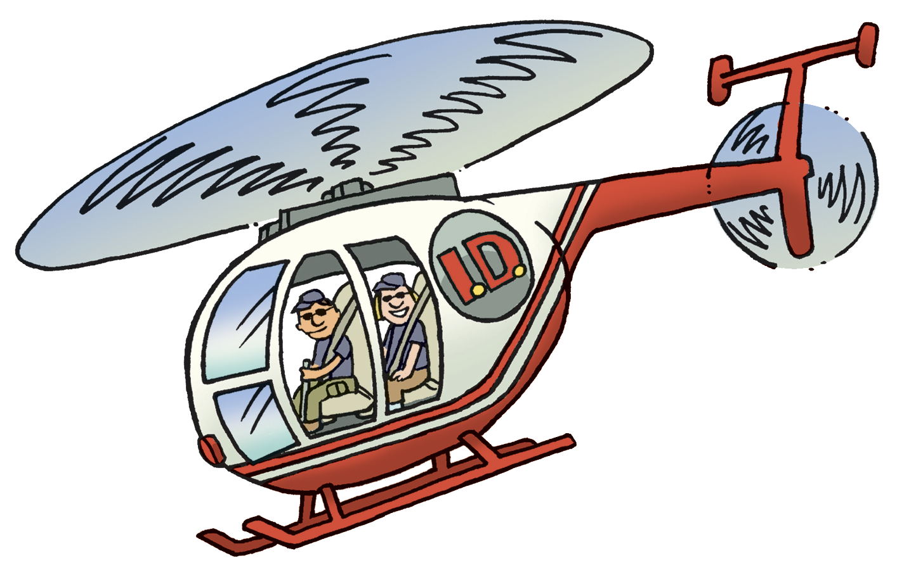
Parent expectations
Parent/Student Portal
Parental Involvement - Yes!
Student Independence/Ownership & Problem Solving Skills
Organizational skills (daily agenda)

Slide 7
Off-island trip
Philippines!
Target date
Fundraising/costs
Activities – Mrs. Kaible

